Slide 1
Setting Up an Initial Lab Environment
Notes:
https://www.cfreds.nist.gov/data_leakage_case/data-leakage-case.html

Slide 2
Data Leakage Case Description

Slide 3
Purpose
The purpose of this work is to learn various types of data leakage, and practice its investigation techniques.
Case is designed by NIST
https://cfreds-archive.nist.gov/data_leakage_case/data-leakage-case.html

Slide 4
Scenario Overview (1) - background
Iaman Informant was working as a manager of the technology development division at a famous international company OOO
OOO developed state-of-the-art technologies and gadgets.
Mr. Informant was also very interested in IT (Information Technology), and had a slight knowledge of digital forensics.
The information security policies of OOO include
All storage devices such as HDD, SSD, USB memory stick, and CD/DVD are forbidden under the ‘Security Checkpoint’ rules.
All employees are required to pass through the ‘Security Checkpoint’ system.
Confidential electronic files should be stored and kept in the authorized external storage devices and the secured network drives.
Confidential paper documents and electronic files can be accessed only within the allowed time range from 10:00 AM to 16:00 PM with the appropriate permissions.
Non-authorized electronic devices such as laptops, portable storage, and smart devices cannot be carried onto the company.

Slide 5
Scenario Overview (2) – data leakage
One day, Mr. Informant received an offer from ‘Spy Conspirator’ to leak sensitive information related to the newest technology.
Mr. Conspirator was an employee of a rival company, and Mr. Informant decided to accept the offer for large amounts of money, and began establishing a detailed leakage plan.
Mr. Informant made a deliberate effort to hide the leakage plan.
He discussed it with ‘Mr. Conspirator’ using an e-mail service like a business relationship. He also sent samples of confidential information through personal cloud storage.
After receiving the sample data, Mr. Conspirator asked for the direct delivery of storage devices that stored the remaining (large amounts of) data.
Eventually, Mr. Informant tried to take his storage devices away

Slide 6
Scenario Overview (3) – security checkpoint
Mr. Informant and his devices were detected at the security checkpoint of the company.
he was suspected of leaking the company data.
At the security checkpoint, although his devices (a USB memory stick and a CD) were briefly checked (protected with portable write blockers), there was no evidence of any leakage.
And then, all devices were immediately transferred to the digital forensic laboratory for further analysis.
In this scenario, find any evidence of the data leakage, and any data that might have been generated from the suspect’s electronic devices.

Slide 7
Digital Forensic Practice Topics
Practice Point | Description | Practice Point | Description
Understanding Types of Data Leakage | - Storage devices > HDD (Hard DiskDrive), SSD (Solid State Drive) > USB flash drive, Flash memory cards > CD/DVD (with Optical Disk Drive) - Network Transmission > File sharing, Remote Desktop Connection > E-mail, SNS (Social Network Service) > Cloud services, Messenger | E-mail Forensics | - MS Outlook file examination - E-mails and attachments
Windows Forensics | - Windows event logs - Opened files and directories - Application (executable) usage history - CD/DVD burning records - External devices attached to PC - Network drive connection traces - System Caches - Windows Search databases - Volume Shadow Copy | Database Forensics | - MS Extensible Storage Engine (ESE) Database - SQLite Database
File System Forensics | - FAT, NTFS, UDF - Metadata (NTFS MFT, FAT Directory entry) - Timestamps - Transaction logs (NTFS) | Deleted Data Recovery | - Metadata based recovery - Signature & Content based recovery (aka Carving) - Recycle Bin of Windows - Unused area examination
Web Browser Forensics | - History, Cache, Cookie - Internet usage history (URLs, Search Keywords…) | User Behavior Analysis | - Constructing a forensic timeline of events - Visualizing the timeline

Slide 8



Learning approach for the class
https://cfreds-archive.nist.gov/data_leakage_case/leakage-answers.pdf

Slide 9
Set up lab

Slide 10
Lab setup procedures
Install Kali (Optional)
Get the NIST data leakage case DD image
Exam files in the DD image
Extract registry files from the DD Image
Extract prefetched event log files from the DD Image
Extract security event log files from the DD Image
Install tree, Install RegRipper 3.0, Windows-Prefetch-Parser
Notes:
sudo su

Slide 11
Install Kali (Optional)

Slide 12
Download and installation instructions
https://github.com/frankwxu/digital-forensics-lab
Read Tool installation section

Slide 13
Get the NIST data leakage case image

Slide 14
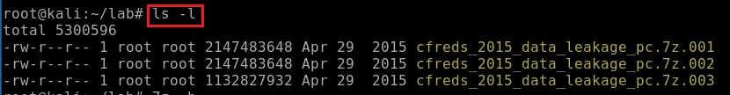
How to download the DD image?
Download DD images. See notes if the link expired
Repeat wget command to download .002 and .003
https://cfreds-archive.nist.gov/data_leakage_case/images/pc/cfreds_2015_data_leakage_pc.7z.001
https://cfreds-archive.nist.gov/data_leakage_case/images/pc/cfreds_2015_data_leakage_pc.7z.002
https://cfreds-archive.nist.gov/data_leakage_case/images/pc/cfreds_2015_data_leakage_pc.7z.003
Verify three zipped files
Notes:
Backup links
https://www.dropbox.com/s/u4axlx8eomgwfdc/cfreds_2015_data_leakage_pc.7z.001
https://www.dropbox.com/s/pyq50s2cri6yftf/cfreds_2015_data_leakage_pc.7z.002
https://www.dropbox.com/s/cxvzuiupmqc7l99/cfreds_2015_data_leakage_pc.7z.003

Slide 15
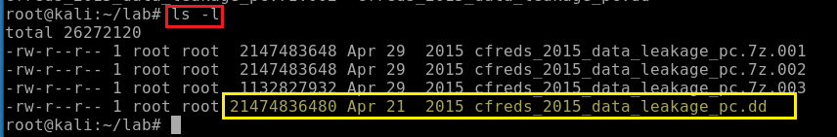
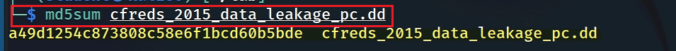
unzipped the DD image
Verify the unzipped DD image
Verify the unzipped DD image with MD5
Notes:
7z e cfreds_2015_data_leakage_pc.7z.001

Slide 16
Exam files in the DD image

Slide 17
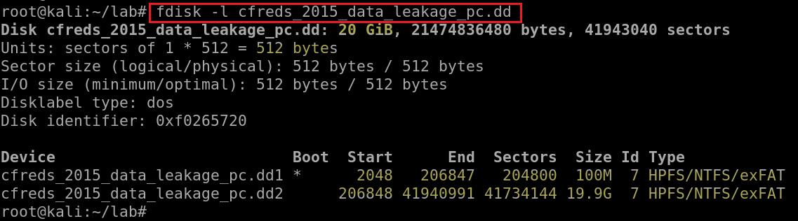
Which partition is the system volume?
Exam partitions of the DD image using fdisk (format disk)
"system" volume: initial booting process and system startup
"boot" volume: core os
the device is bootable, not a boot partition
Notes:
http://blog.hakzone.info/posts-and-articles/linux/disk-analysis-with-fdisk-mmls-fsstat-and-fls/
Block devices are characterized by random access to data organized in fixed-size blocks. Examples of such devices are hard drives, CD-ROM drives, RAM disks, etc.
fdisk also known as format disk is a dialog-driven command in Linux used for creating and manipulating disk partition table. It is used for the view, create, delete, change, resize, copy and move partitions on a hard drive using the dialog-driven interface.
fdisk -l cfreds_2015_data_leakage_pc.dd

Slide 18
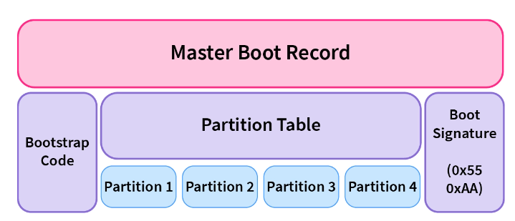
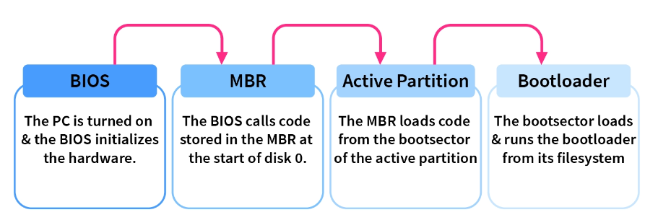
System Volume | Boot Volume
contains essential system files and configurations required for the initial booting process and system startup | the core operating system files are stored
includes boot files such as the Master Boot Record (MBR) or GUID Partition Table (GPT) | contains files like the Windows system files (e.g., in Windows environments) and program files.
essential for the operating system to locate and load the necessary files for booting. | is where the operating system continues to run once the boot process is complete.
 | the boot volume is assigned a drive letter (such as "C:" in Windows)
https://www.scaler.com/topics/operating-system/master-boot-record/

Slide 19
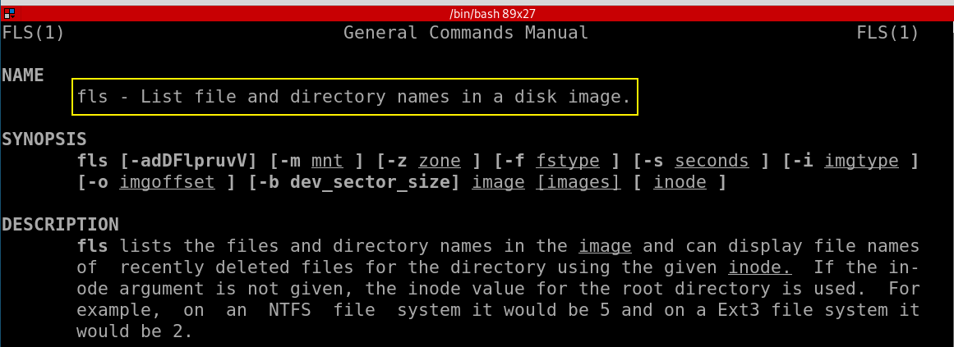
Which command to list file/directory names in a system volume?

Slide 20
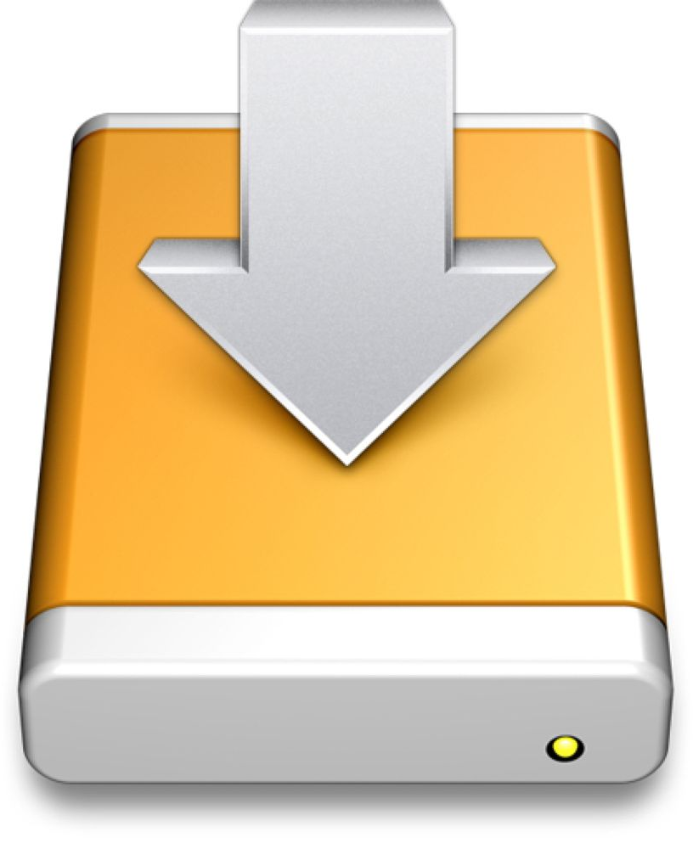
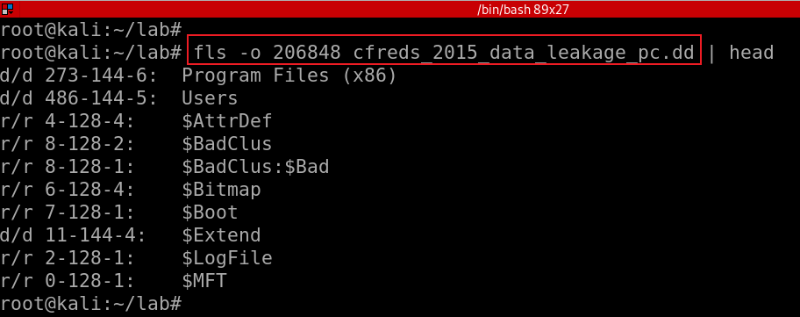
List file/directory names of the system volume
-o: offset of a partition
FAT/exFAT: Directory entry (USB)
NTFS: MFT Entry (Win)
UFS: Inode (Digital camera, mobile phone)
ExtX: Inode (Linux)
HFS: Catalog record (Ios)
r/ r: Regular file
'r': saved in the file's file name structure
'r' : saved in the file's metadata structure.
For allocated files, these should always be equal.
For deleted files, they could be different if one of the structures was reallocated to a different file type.
d: Directory
273: the entry of metadata address
metadata address: is a term that is used in the sleuth kit (TSK) as a generic term for the addresses of file system-specific data structures
-144-6 (for NTFS), identifies the $Data attribute that this name points to.
Notes:
fls -o 206848 cfreds_2015_data_leadage_pc.dd
https://wiki.sleuthkit.org/index.php?title=Fls

Slide 21
Extract key registry files from a DD image

Slide 22
Overview
What is Windows Registry?
How to access registry files?
How to copy registry files for future forensic analysis?

Slide 23
4.1 What is Windows Registry?
University
College
CS Dept.
Criminal Justice Dept.
Admin
The Windows Registry is a database
Stores low-level settings for the Microsoft Windows operating system
Store setting for applications that opt to use the registry.
It is a hierarchical database
Store forensic information
Components use registry
Kernel: the core component of an OS
Device drivers: software components that facilitate communication between the OS and hardware devices
Services: background processes that provide specific functions to the OS or apps
Security Accounts Manager (SAM): managing user accounts and security settings
User interface: through which users interact with and control the computer or software

Slide 24





User
Investigate
Users and investigators interact with the Windows registry
Investigator

Slide 25
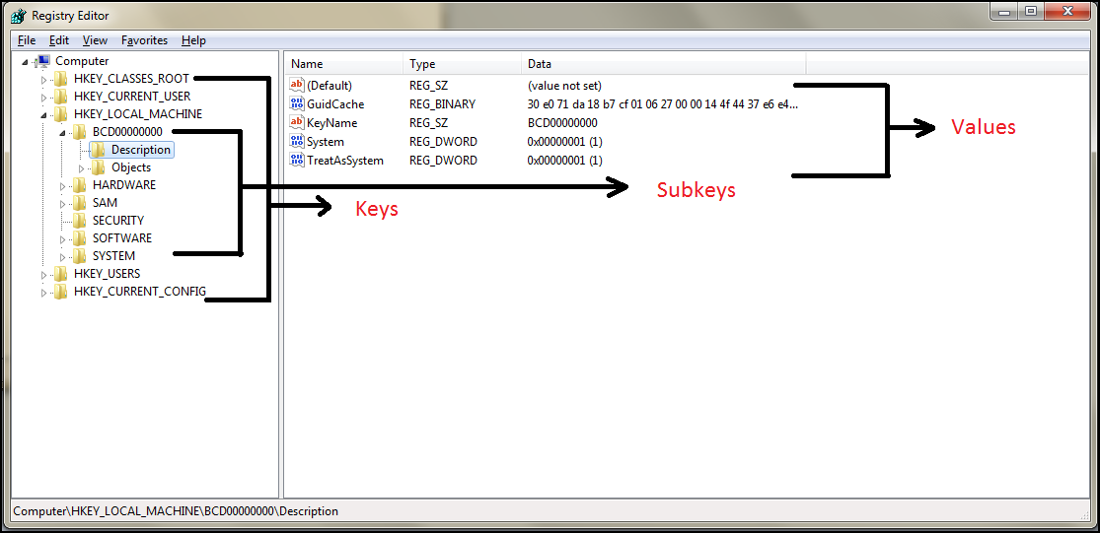
The five main root keys of registry are:
HKEY_CLASSES_ROOT (HKCR)
HKEY_CURRENT_USER (HKCU)
HKEY_LOCAL_MACHINE (HKLM)
HKEY_USERS (HKU)
HKEY_CURRENT_CONFIG (HKCC)

Slide 26
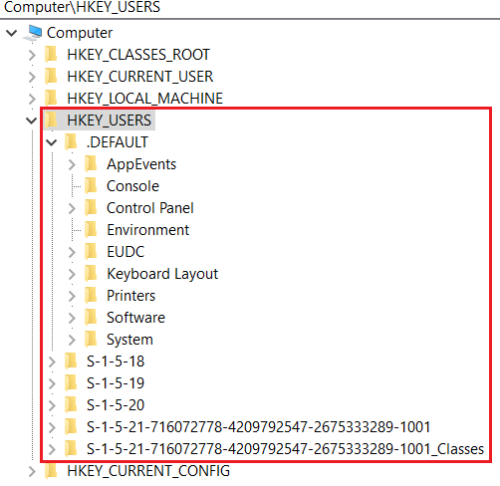
HKEY_USERS (HKU)
Contains information about all the users who logged in to the computer at some point
When log on, the current logged in user profile is linked by HKCU
Saved in each user's profile folder
C:\Users\IEUser\Ntuser.dat
C:\Users\ssh_Server\Ntuser.dat
C:\Users\Default User\Ntuser.dat
contains the base settings for new users when they first logon,

Slide 27
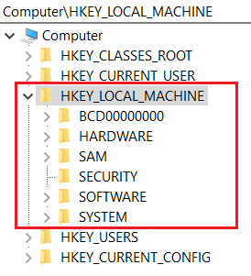
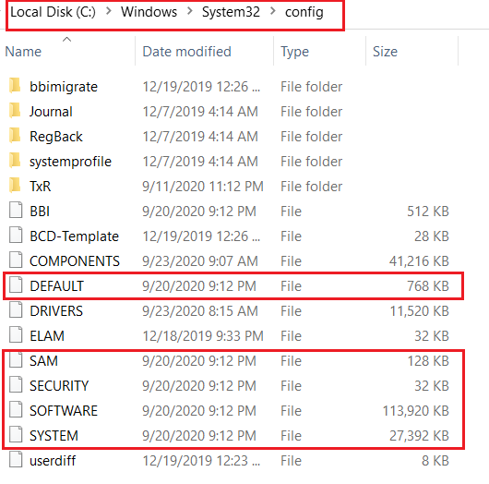
HKEY_LOCAL_MACHINE (HKLM)
Contains computer hardware and software information
Loaded at boot time from
Store Plug-and-Play devices Infor
Created dynamically, not stored in a file
Loaded at boot time from

Slide 28
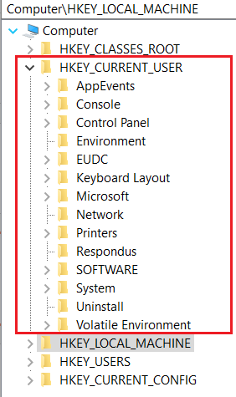
HKEY_CURRENT_USER (HKCU)
Does not contain any data
A link to the subkey of HKEY_USERS
Stores settings for currently logged-in use
Unloaded when the user logs out
If no profile is available, built from the default user
Control everything of the current logged-in user
Environment variables
Desktop settings,
Network connections, printers,
Application preferences.
Keyboard layout
Current logged user information
Treasure for investigators

Slide 29
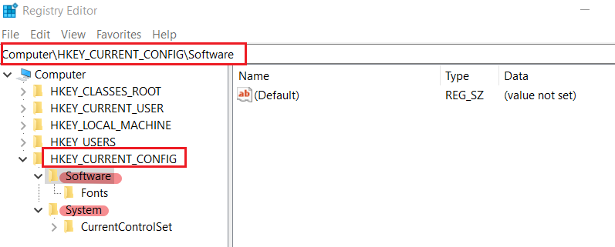
HKEY_CURRENT_CONFIG (HKCC)
It doesn't store any information itself but instead acts as a pointer, or a shortcut, to a registry key
Noting shown here, but points to other registry

Slide 30
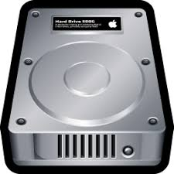

4.2 How to access registry files in dd image ? the easiest way: Mounting
root
bin
cp
mv
home
student1
student2
mnt
chip
step 1: create a virtual device
step 3: attach device
to the access point
/dev/loopN
mount
losetup
loop device
.dd raw
step 2: create a folder
as an access point
(to a device)
a virtual device in Unix-like systems that allows a file to be accessed as if it were a physical storage device, such as a hard drive or USB drive.
Notes:
A loop device, often referred to as a loopback device, is a virtual device in Unix-like operating systems (including Linux) that allows a file to be accessed as if it were a block device or a physical storage device, such as a hard drive or USB drive. Loop devices are particularly useful for mounting and working with filesystems stored within regular files. Here are some key points about loop devices:
File as a Block Device: A loop device enables a regular file to be treated as a block device. This means you can use a file to simulate a disk or partition, and then you can create a filesystem on it, mount it, and use it like any other storage device.
Mounting Filesystems: Loop devices are often used to mount filesystems that are stored within files. For example, you can have a file containing a filesystem (e.g., an ISO image or a disk image), and you can use a loop device to mount that file so you can access its contents.
Creation and Usage: You can create a loop device by associating it with a specific file using the losetup command in Linux. Once a loop device is set up, you can mount it, read from it, and write to it, just as you would with a physical storage device.
Common Use Cases: Loop devices are used in various scenarios, including mounting disk images, working with ISO files, and creating encrypted filesystems within files.
Unmounting and Detaching: When you're done using a loop device, you should unmount it like any other mounted filesystem and then detach it from the associated file using the losetup -d command.

Slide 31
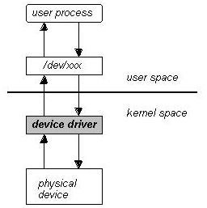
Technical view of Mounting
Users access a device through a folder
Set up a loop device
Create a mounting point
Attach the loop device to the mount point
2. folder
3
1
Mounting options: auto-mounting vs. manually mounting process

Slide 32
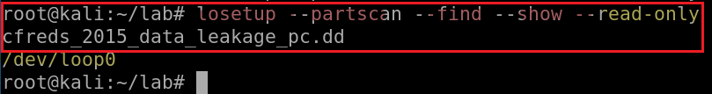
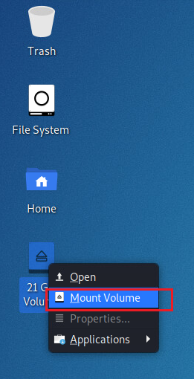

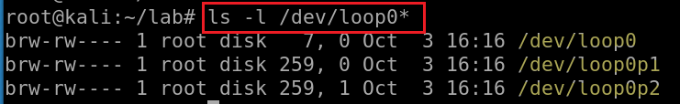
If your VM supports auto-mounting
--partscan: scan the partition table on a newly created loop device
--find: find the first unused loop device.
--show: print device name
--read-only: setup read-only loop device.
Set up loop device (a pseudo-device that makes a file accessible as a block device)
Try to add sudo to get admin privilege if above cmd doesn’t work.
Otherwise, you have to manually mount the image
Show disk (loop0), partition 1 (loop0p1), partition 2 (loop0p2)
Notes:
losetup --partscan --find --show --read-only cfreds_2015_data_leakage_pc.dd
losetup --detach /dev/loop0
losetup --detach-all
them unmount /dev/loop0
use sudo su if you have any troubles

Slide 33
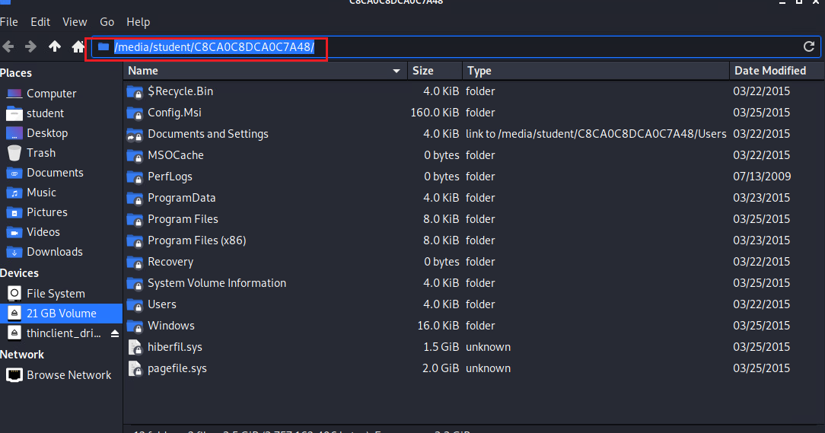
Show mounted image

Slide 34
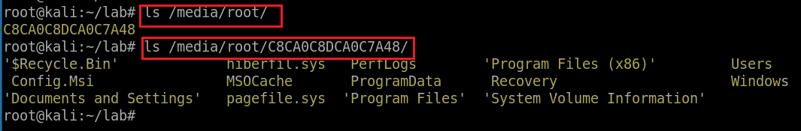
Kali 2020 automatically create the mounting point /media/YOUR_Account/CB…48. The partition 2 is mounted to the mounting point
Notes:
mount -o ro,loop,offset=206848 cfreds_2015_data_leakage_pc.dd /mnt/loopdev
umount /mnt/nist_dataleak_pc_dd2/
fusermount -uz /data

Slide 35
If your VM doesn’t support auto-mounting
Create a folder as the mount point
Mount partition 2 to the mounting point
Unmount command: umount /mnt/nist_dataleak_pc_dd2/
Notes:
mount -o ro,loop,offset=206848 cfreds_2015_data_leakage_pc.dd /mnt/loopdev
umount /mnt/nist_dataleak_pc_dd2/
fusermount -uz /data

Slide 36
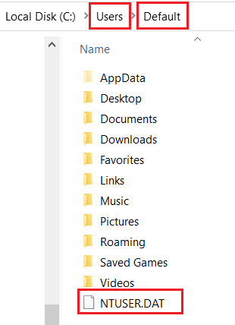
4.3 How to copy registry files for future forensic analysis?
Files contain HKEY_LOCAL_MACHINE
Files contains HKEY_USERS

Slide 37
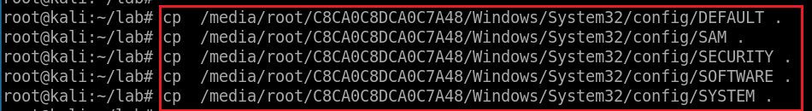
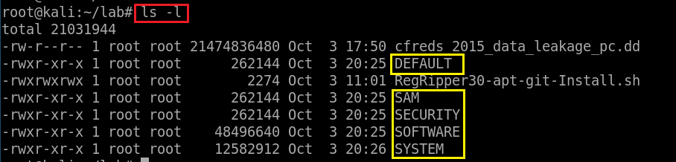
Copy HKEY_LOCAL_MACHINE (Hive) files to \lab
Verify five files

Slide 38
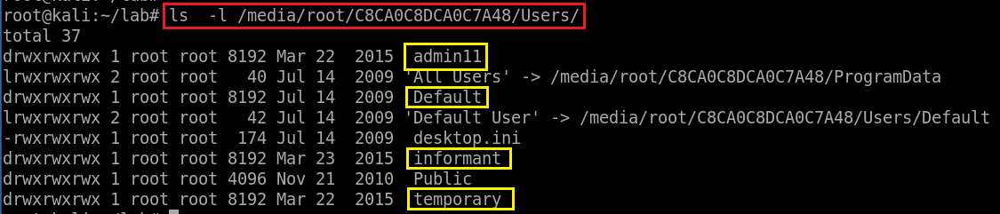
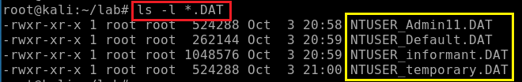
Find users in the PC
Find copy HKEY_USERS hive files to \lab
Verify four files

Slide 39
Extract prefetch event log files from a DD image
monitoring program execution

Slide 40
Prefetch introduction
What is Cache?
Is type memory that stores data to improve performance
What is Prefetching?
The loading of a resource (instructions, data) to cache before it is required
Which resource are chosen for prefetching?
Chosen based on the user’s daily behavior
E.g., the most used resource
Prefetch log can be used for forensic analysis
E.g., monitoring program execution

Slide 41
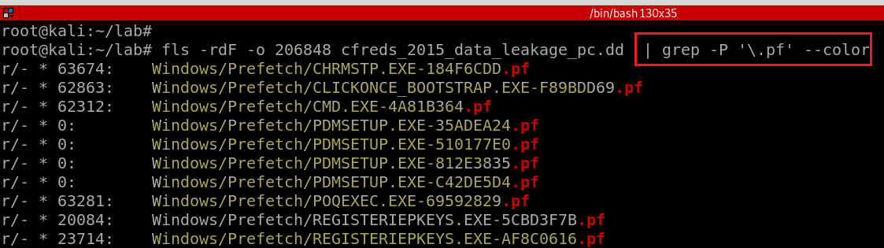
Check .pf files in a DD image
-r: recursively, -F: Display only files, -d: deleted files
-P: PCRE - Perl Compatible Regular Expressions
\: Escapes a special character
note: always enclose the regular expression in single quotes
grep supports three regular expression syntaxes, Basic, Extended, and Perl-compatible.
A regular expression or regex is a pattern that matches a set of strings
https://www.debuggex.com/cheatsheet/regex/pcre
Notes:
https://linuxize.com/post/regular-expressions-in-grep/

Slide 42
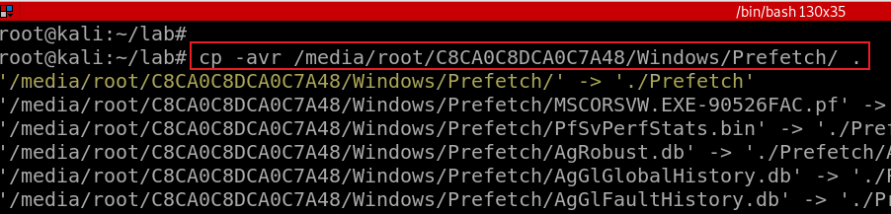
Copy Prefetch folder to current folder
-a : Preserve the specified attributes such as directory a file mode, ownership, timestamps, if possible additional attributes: context, links, xattr, all.
-v : Verbose output.
-r : Copy directories recursively.
Notes:
mkdir Prefetch
cp -avr /media/root/C8CA0C8DCA0C7A48/Windows/Prefetch/ ./Prefetch/

Slide 43
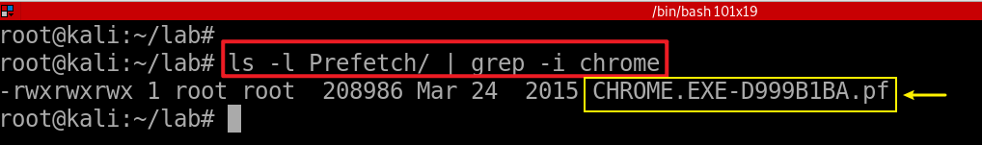
Verify and check .pf of chrom.exe is in ./Prefetch folder

Slide 44
Extract security event log files from the DD Image

Slide 45
Event log files overview
Windows OS records various events for debugging
Created by the Windows 7 Event Viewer (eventvwr.msc)
Event logs has file extension .evtx
Contains a list of events
Saved in a proprietary binary format
Only can be viewed within the Event Viewer

Slide 46
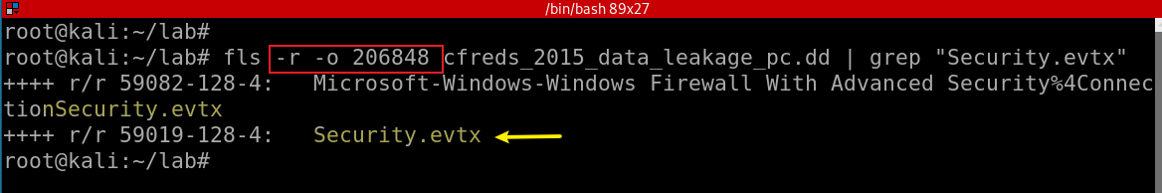
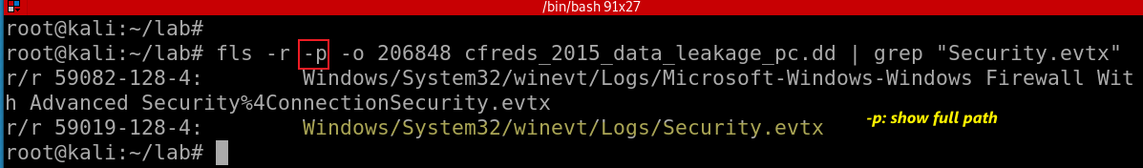
Search for “Security.evtx” from the DD image
-r: Recurse on directory entries
Search for “Security.evtx” from the DD image and show full path
Notes:
fls -r -o 206848 cfreds_2015_data_leakage_pc.dd | grep "Security.evtx"
fls -r -p -o 206848 cfreds_2015_data_leakage_pc.dd | grep "Security.evtx"

Slide 47
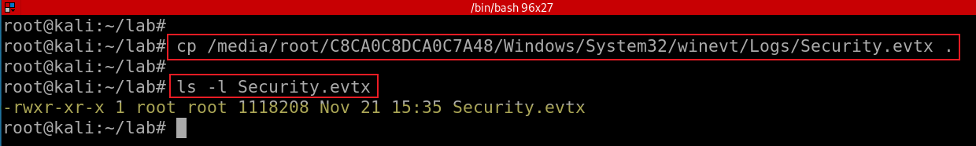
Copy “Security.evtx” from the DD image to the lab directory

Slide 48
Install software
Optional: If you downloaded Kali form https://github.com/frankwxu/digital-forensics-lab, you can skip this section

Slide 49
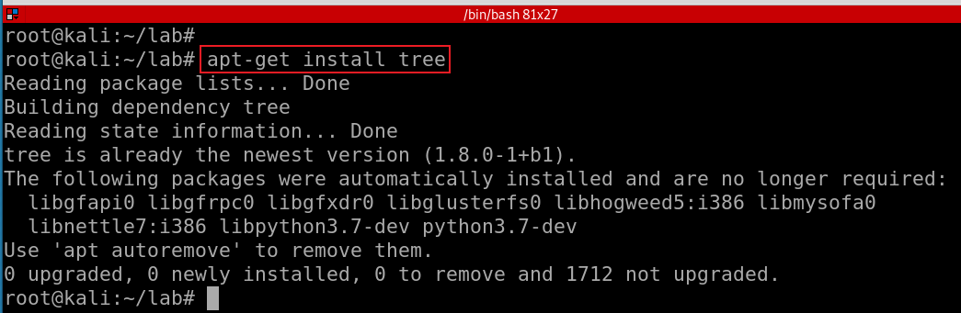
7.1 Install tree

Slide 50
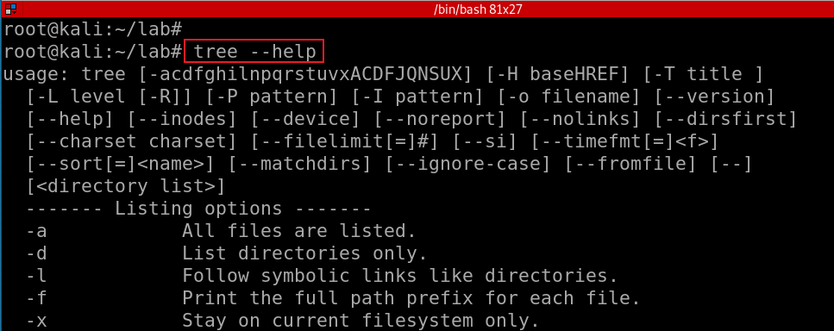
Show tree help menu

Slide 51
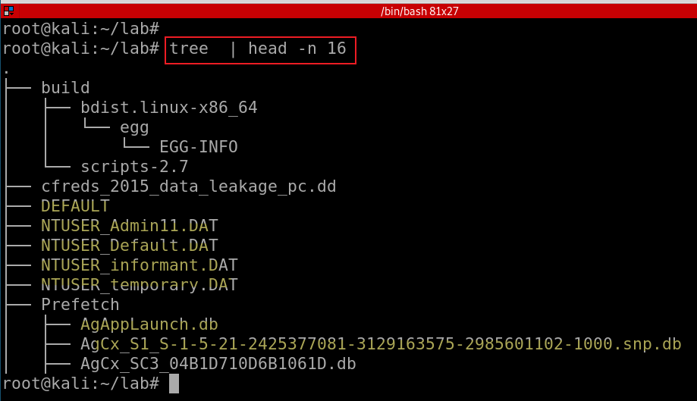
Show files of the current folder in a tree structure
Notes:
sudo apt-get install tree

Slide 52
7.2 Install RegRipper 3.0
RegRipper is a software tool to extract/parse information (keys, values, data) from the Registry
Open-source software (Windows and Linux)
Written in Perl
Consists of a framework that executes plugins
Two basic tools
A command line (CLI) tool called rip
Graphic user interface (GUI)

Slide 53
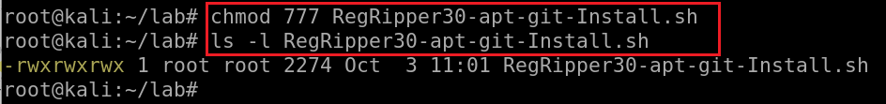
Download RegRipper 3.0 installation script
use the backup link if the original link does not work
Verify the script
Make the script executable
Notes:
wget https://raw.githubusercontent.com/frankwxu/digital-forensics-lab/main/NIST_Data_Leakage_Case/tools/RegRipper30-apt-git-Install.sh
https://medium.com/@stdout_/installing-regripper-v2-8-on-ubuntu-26dc8bc8a2d3
https://github.com/keydet89/RegRipper3.0

Slide 54
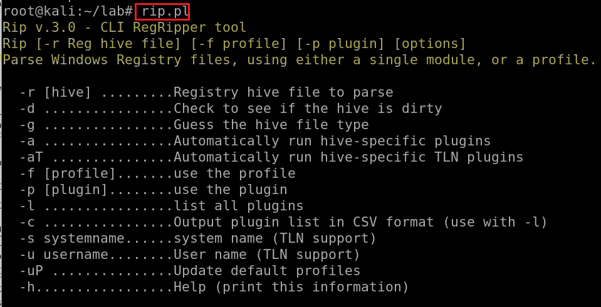
Run the script to install
Test regripper 3.0

Slide 55
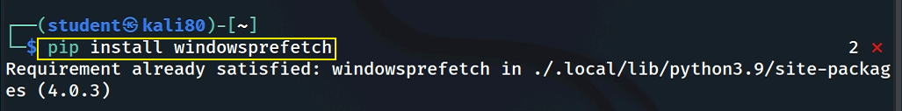
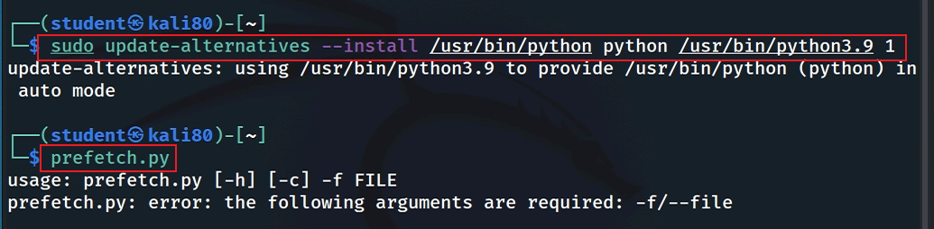
7.3 Install Windows-Prefetch-Parser
Install parser
Test if prefetch tool works (you can skip if your python version is 3.9)
Notes:
https://github.com/PoorBillionaire/Windows-Prefetch-Parser.git
pip install windowsprefetch
sudo update-alternatives --install /usr/bin/python python /usr/bin/python3.9 1
https://medium.com/analytics-vidhya/how-to-install-and-switch-between-different-python-versions-in-ubuntu-16-04-dc1726796b9b

Slide 56
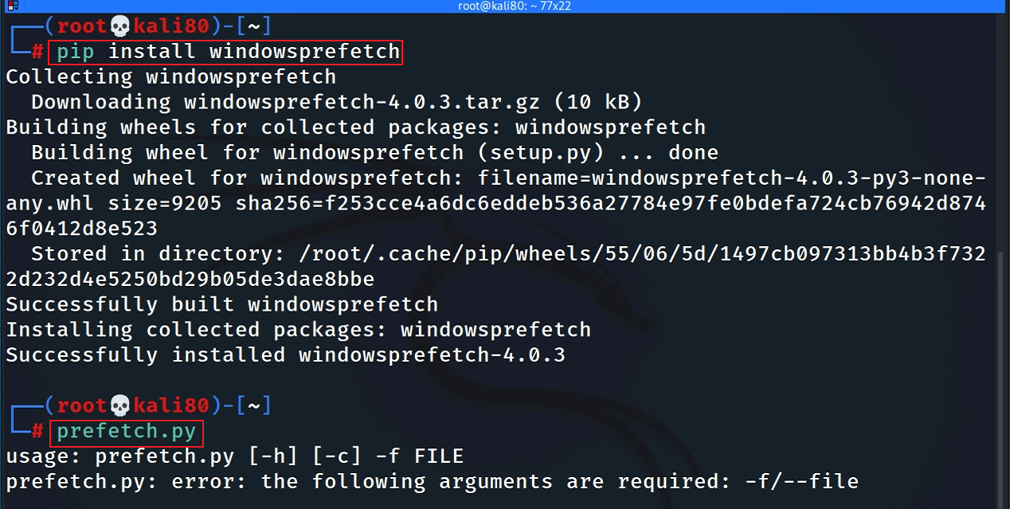
If you are the root

Slide 57
Last option: Directly build from GitHub
git clone https://github.com/PoorBillionaire/Windows-Prefetch-Parser.git
cd Windows-Prefetch-Parser
python3 setup.py build
python3 setup.py install
prefetch.py

Slide 58
7.4 Install Window event log parser: Python-evtx
A pure Python parser for recent Windows Event Log files
Parse files with ".evtx“
Provides programmatic access to the File and Chunk headers, record templates, and event entries

Slide 59
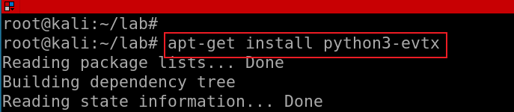
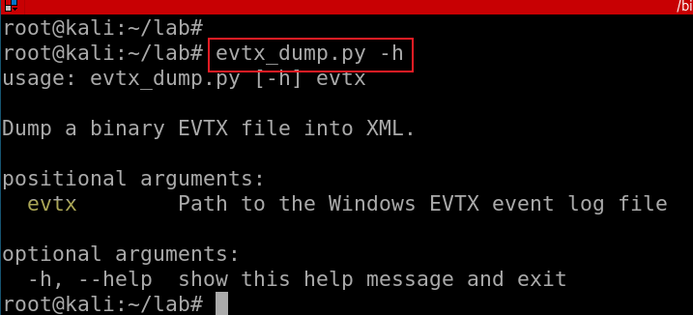
Install via apt
Run apt-get update if there is any error message
Verify installation
Notes:
Apt-get install python3-evtx

